Slide 1
Creating views

Slide 2
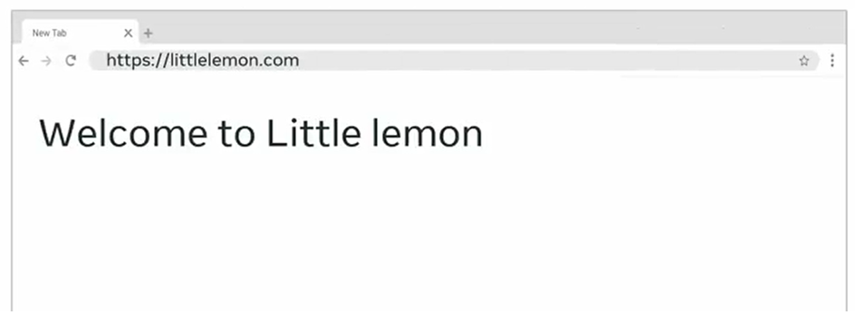

Slide 3

Views.py

Slide 4
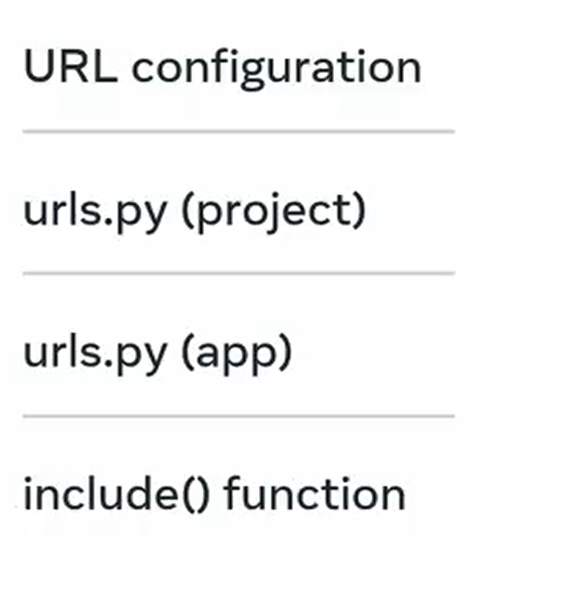

Slide 5


Slide 6


Slide 7
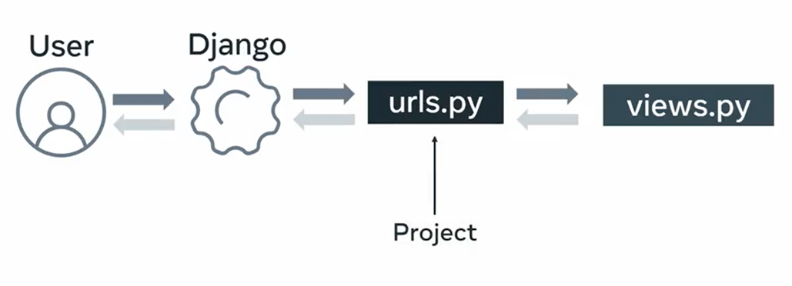

Slide 8
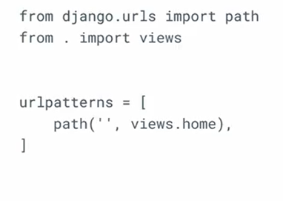
urls.py(app)

Slide 9
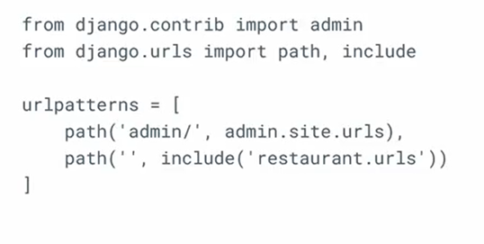
Urls.py(project)

